Slide 1






INCLUSION IN EDUCATION IN CROATIA:
The Case of
School of Crafts Osijek
Presented by:
Maja Zorić
Notes:
I will talk about inclusive education in Croatia. My presentation focuses on students with difficulties. First, I will briefly explain the Croatian education system. Then I will present how inclusion works in practice at my school.

Slide 2
In Croatia, the term students with difficulties is used instead of students with special educational needs (SEN).
2
Notes:
In the Croatian education system, the term students with difficulties is used instead of students with special educational needs. In this presentation, I will use Croatian terminology.

Slide 3
Act on Primary and Secondary Eeducation
Students with difficulties include:
students with developmental difficulties,
students with learning difficulties, behavioural problems and emotional difficulties,
students with difficulties caused by educational, social, economic, cultural and linguistic factors.
3
Notes:
Croatian law defines who students with difficulties are. This includes students with developmental difficulties, learning difficulties, behavioural and emotional difficulties, as well as students with difficulties related to social, cultural and language factors.

Slide 4
Regulation on Primary and Secondary Education of Students with Developmental Difficulties
Education Programmes for Students with Developmental Difficulties:
Regular programme with individualisation
Regular programme with adapted content
Special programme
Special programme for life and work skills
4
Notes:
Based on national regulations, several education programmes are available. Students can be educated in regular programmes with individualised approach, regular programmes with adapted content, or special programmes. The choice depends on the type and level of difficulty.

Slide 5
Croatian Education System
Regular primary and secondary schools
Special primary and secondary schools for students with more severe difficulties
Special classes within regular schools (when required)
5
Notes:
In Croatia, there are regular and special primary and secondary schools. When necessary, special classes can be organised within regular schools. This allows students to receive support while remaining in the school system.

Slide 6

Primary and Secondary Education
Compulsory
(Grades 1–8)
Not compulsory
6
Notes:
Primary education in Croatia is compulsory. It lasts from Grade 1 to Grade 8. Secondary education is not compulsory, but most students continue their education.

Slide 7
Regular Classes
Regular programme with individualised approaches
Regular programme with adapted content
Secondary Education Pathways for Students with Difficulties
Special Classes
(Auxiliary Vocational Occupations)
Special programme with individualisation
7
Notes:
Many students with difficulties can continue to secondary education. Access depends on the programme they completed in primary school and, of course, on their individual abilities and needs.
Students who complete regular primary programmes can usually enrol in regular secondary schools and most often choose vocational secondary schools. Students who complete special primary programmes continue their education in special schools or special classes.

Slide 8
Regular Programme (Regular Classes)
Individualised Approaches
working time
teaching methods
monitoring and assessment of achievement
use of technological, didactic and rehabilitative support
Content Adaptation
reduced scope of curriculum content
learning outcomes above the special programme level
enables achievement of learning outcomes required for the national examinations and continuation of education
development of competencies required for access to the labour market
8
Notes:
As mentioned earlier, students with difficulties may attend regular programmes with individualisation or with adapted content.
Individualisation focuses on how students learn.
This includes adapting working time, teaching methods and assessment with different types of support.
Content adaptation means reducing the scope of curriculum content.
Learning outcomes remain above the level of the special programme.
Although education is adapted, students must still achieve a defined minimum of competencies required for national examinations and for entry into the labour market.

Slide 9
Special Programme (Auxiliary Vocational Programmes)
For students with difficulties who are unable to follow regular programmes, even with adapted content and individualised approaches
Implemented in special classes
Provided by an educational rehabilitator and a subject teacher
9
Notes:
The special programme is intended for students who cannot follow regular programmes, even with adaptations. It is implemented in special classes with up to ten students,
where teaching is fully individualised
and the curriculum is flexible and adapted to each student. Teaching is provided by an educational rehabilitator and a subject teacher.

Slide 10
Case Study:
School of Crafts Osijek
10
Notes:
So far, I have explained the national education framework. Now I will show how inclusive education works in practice at the School of Crafts Osijek.

Slide 11
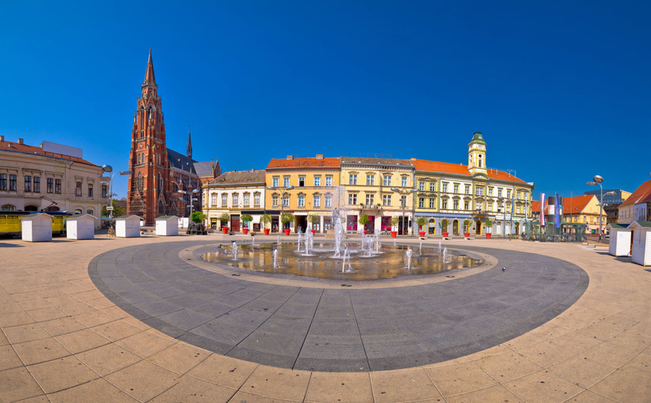
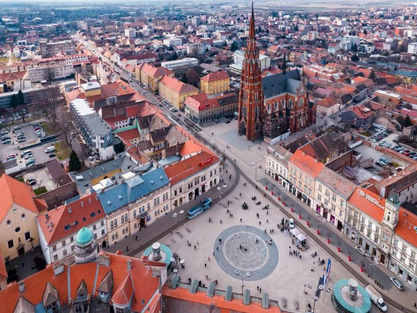

About Osijek
City in eastern Croatia, located on the Drava River
Fourth largest city in Croatia
Administrative, educational and cultural centre of the region
11
Notes:
First, let me tell you a few words about Osijek. Osijek is a city in eastern Croatia. It is located on the Drava River. Osijek is an important educational, cultural and regional centre and it is a university city. Osijek has around 80,000 inhabitants. But, many people from nearby villages and smaller towns come to Osijek for work, education and healthcare.
In the photos, you can see the Upper Town, which developed in the late 19th and early 20th century.

Slide 12
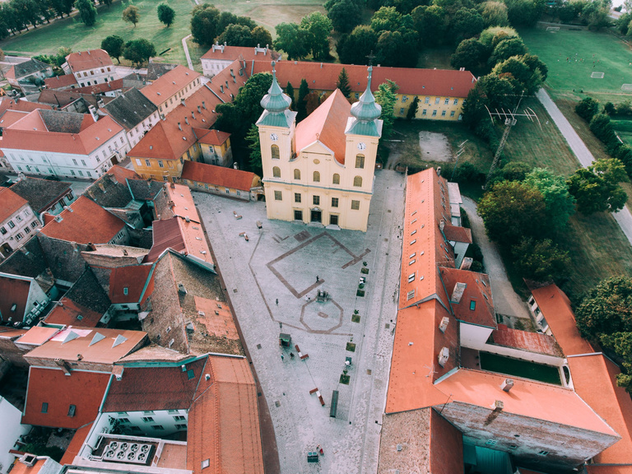
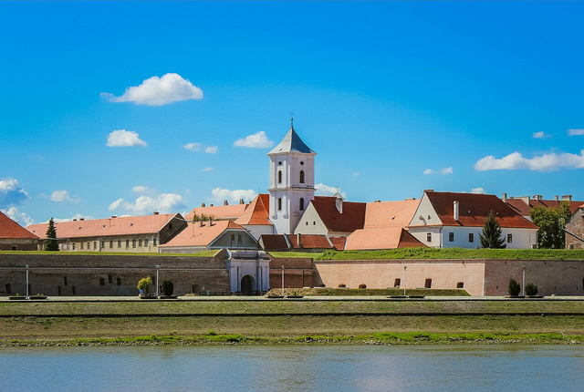
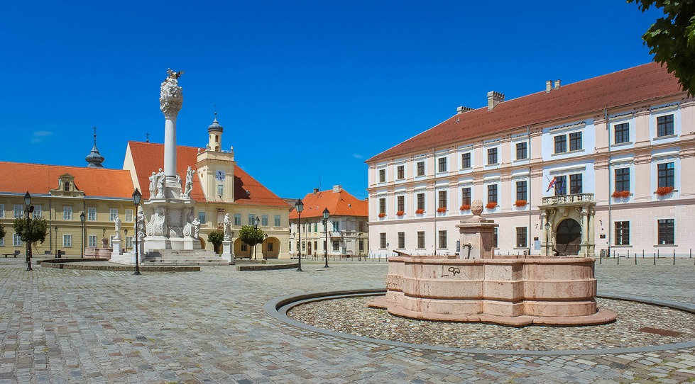
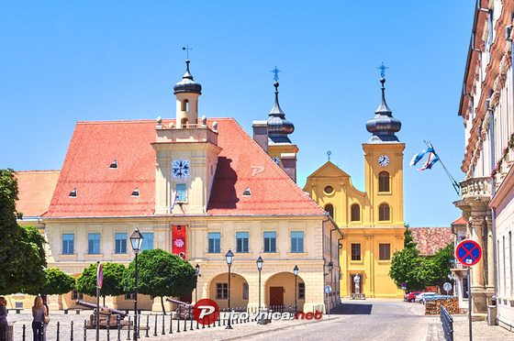
12
Notes:
Here you can see the old part of Osijek, built in the 18th century, which still has parts of its original walls.

Slide 13
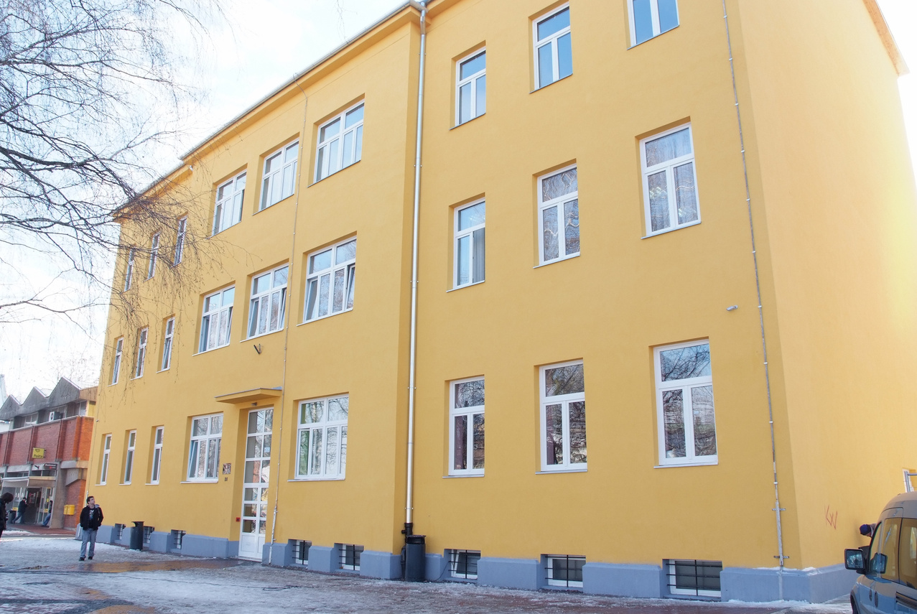
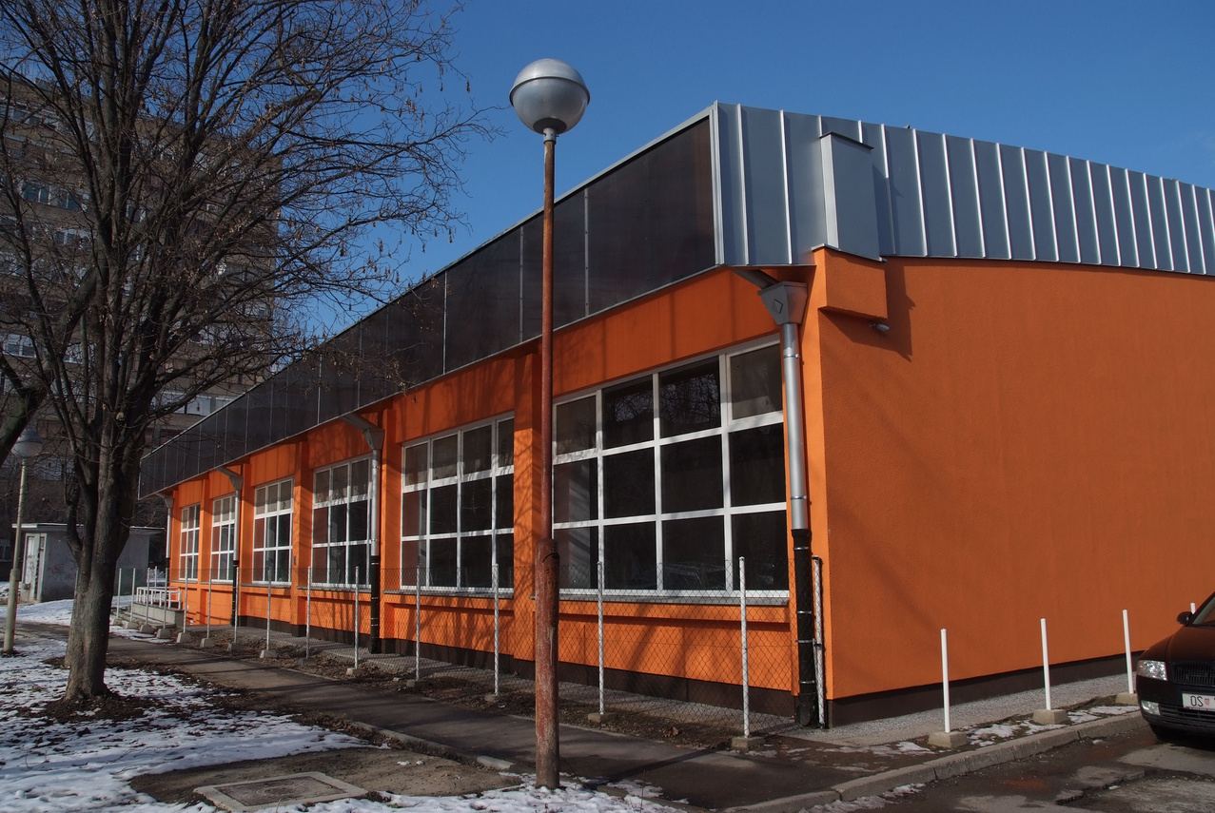
School of Crafts Osijek
Public vocational secondary school
Offers three- and four-year vocational programmes
Educates students in regular and special programmes
Close cooperation with the world of work
13
Notes:
The School of Crafts Osijek is a public vocational secondary school. We offer three- and four-year vocational programmes. Students are educated in regular and special programmes.

Slide 14
School of Crafts Osijek
242 students | 21 classes | 34 teachers | 46 staff members
Regular Programme
Hairdresser
Pedicurist
Photographer
Tailor
Butcher
Baker
Car painter
Carpenter
Special Programme (Auxiliary Vocational Programmes)
Assistant cook
Assistant baker
Assistant florist
Assistant tailor
Assistant locksmith
Assistant plumber
Assistant car painter
14
Notes:
Our school has 242 students and 21 classes. There are 34 teachers and 46 staff members. We offer regular crafts occupations, such as hairdresser, butcher and carpenter, and auxiliary occupations for students with more severe difficulties.

Slide 15
Students with Difficulties
11 regular classes
192 students
10 special classes
39 students
50 students
15
Notes:
As I mentioned earlier, our school has a total of 242 students.
192 of them attend 11 regular classes.
Among them, there are 39 students with difficulties.
Special classes are attended by 50 students with more severe difficulties.
This means that approximately one third of all students in our school are students with difficulties

Slide 16
Professional support staff (3)
School pedagogue
Social pedagogue (part-time)
Psychologist (part-time)
Teaching assistants (3)
Communication intermediary (1)
16
Notes:
Students are supported by professional staff, such as a school pedagogue, psychologist and social pedagogue. Some students also have teaching assistants or a communication intermediary.

Slide 17
Most Common Difficulties
Learning and developmental difficulties
Behavioural, emotional and mental health difficulties
Speech, language and communication difficulties
Intellectual disability (mild to moderate)
Multiple disabilities in psychophysical development
17
Notes:
The most common difficulties include learning, developmental, behavioural difficulties and intellectual disabilities

Slide 18
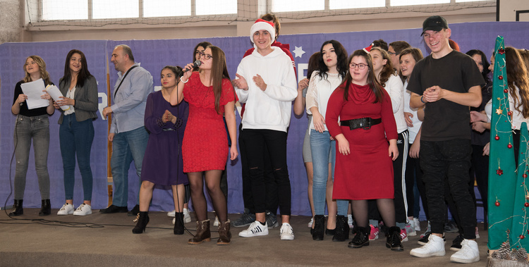
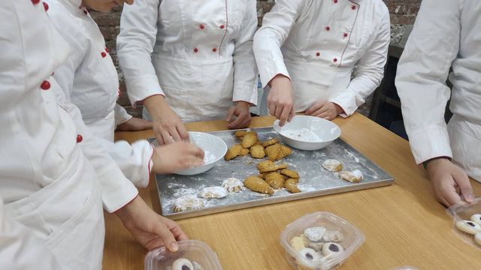
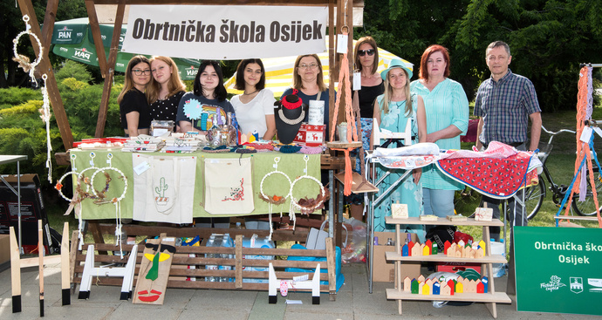
Examples of Inclusive Practice at Our School
Joint school events and celebrations
Joint projects and competitions
Joint workshops and activities
Joint participation in local community events
18
Notes:
Inclusion at our school is part of everyday activities. Of course, during lessons, students in special classes are not integrated with other students. However, students from regular and special programmes participate together in school events, projects and workshops. They also take part together in fairs and events in the local community. These activities support cooperation, social skills and inclusion.

Slide 19
Thank you for your attention.
maja.zoric1@skole.hr
School of Crafts Osijek
Notes:
That is all from me.
Thank you very much for your attention. I would be happy to answer any questions.

